Slide 1

Bell Work:
Factor: Solve:
$x^{2}−19x+18$ $x^{2}+8=6x$

Slide 2
From Last Time
New Material:
Page 244 #1–7, 15–21 (odd), 38
Page 253 #1–6, 9–33(odd), 39–43(odd), 48

Slide 3
ALGEBRA 3
Day 38

Slide 4

Unit 4 Quiz 2: Level 2
Factor
1.) ${ x}^{2}−2x−24$
2.) ${ x}^{2}−36$

Slide 5

Unit 4 Quiz 2: Level 3
Solve
3.) ${ x}^{2}+20=−12x$
4.) ${ 2x}^{2}=−50$

Slide 6
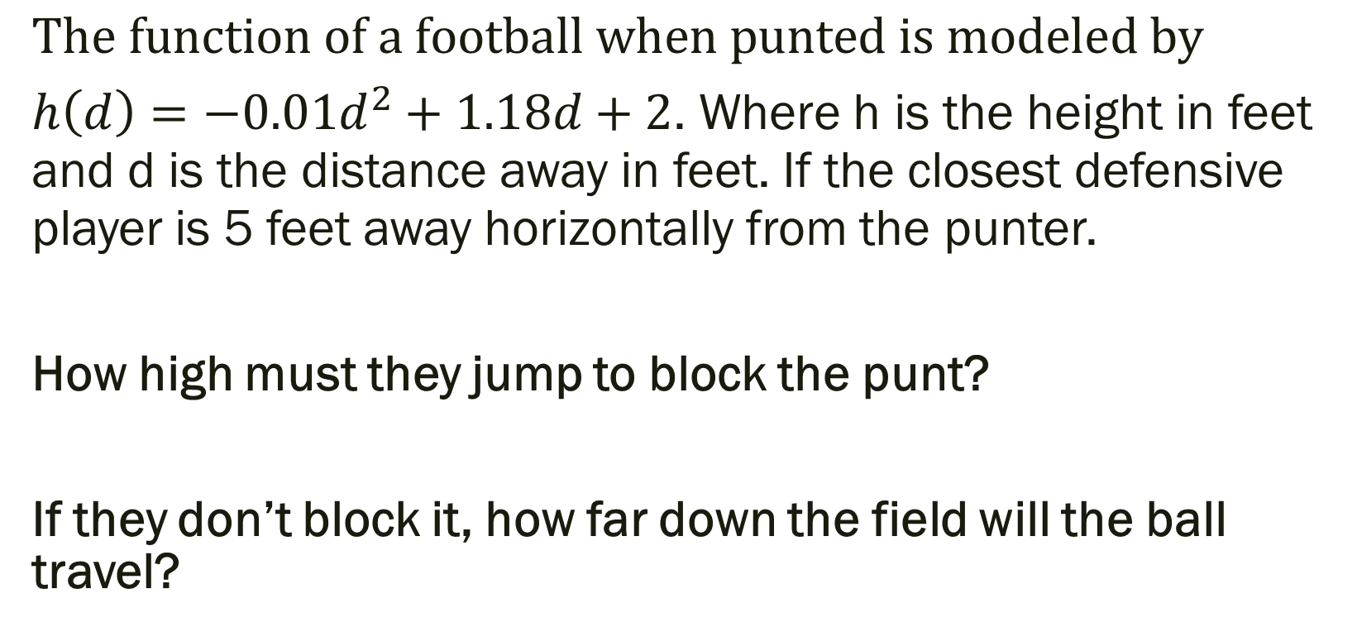
Unit 4 Quiz 2: Level 4
$$The function of a football when punted is modeled by$$ ${h\left(d\right)=−0.01d}^{2}+1.18d+2$. Where h is the height in feet and d is the distance away in feet. If the closest defensive player is 5 feet away horizontally from the punter.
How high must they jump to block the punt?
If they don’t block it, how far down the field will the ball travel?

Slide 7
Things to Study for Quadratics Test
Level 2: Level 4:
Factor (4 problems) Solve a story problem Graph (2 problems) modeling quadratics Simplify with i (5 problems)
Expand on solving a quadratic to other polynomials
Level 3: Solve Quadratic (5 problems) --use any method (graphing, factoring, quadratic formula)

Slide 8
For Next Time
Review for Test:
Page 268 #4–10, 13–16, 21, 27–44,
49–52, 61–64, 70–83

